Slide 1




UNNAMED PROJECT
LUYOLO MBATHA
&
NHLANHLA LANGA

Slide 2
CRIT 1
OUR IDEA
Notes:
Overview

Slide 3
Key Features
01
Customization
02
Music Player
Customise :
Indoor/Outdoor environments
Characters(hair, eye colour etc.)
Log-in to your Spotify/Youtube music
Control the music player
Enjoy Lofi Music as you study
03
Self-study
04
Watch your character
Set a timer, mood and study away
Complete a to-do list, keep yourself on schedule!
Get motivational quotes!
Set a reminder for small breaks
Your character sits on the chair when you're studying
The character jumps up and down when exercising
The player Idles when they have nothing to do

Slide 4
But
Why?
Challenge Ourselves!
To be Industry Prepared
All Or Nothing
Notes:
Why we went with this idea

Slide 5


NHLANHLA
LEAD CHARACTER MODEL
Designing Base Model For Character
Design Systems in Unity
Audio Design
Career Aspirations
Indie Studio Head/CEO
Lead Programmer
Character Designer

Slide 6

LUYOLO
LEAD ASSET DEVELOPER
Art Direction.
Creating 3D assets final iteration .
Importing visual assets to game engine.
Career Aspirations
3D artist - modelling , animator.
3D Printing

Slide 7


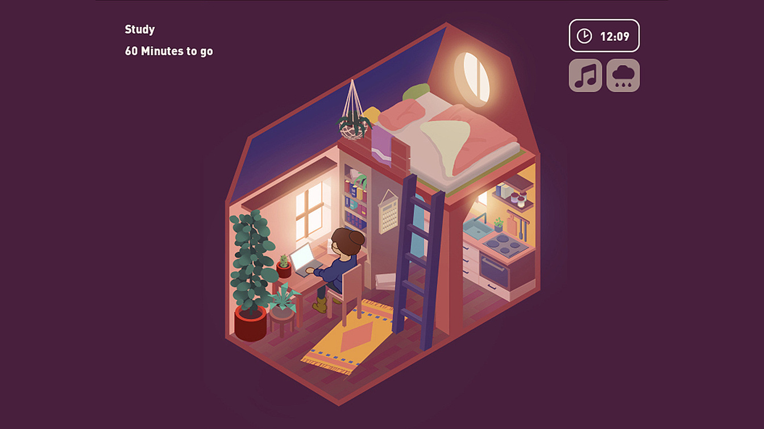
Inspirations
Virtual Cottage
A small application that brings you comfort and productivity!
The game allows players to study and set timers and to do lists
It allows for customising the weather
We were especially fond of the simplistic UI the game used
Notes:
Virtual cottage
Poly

Slide 8
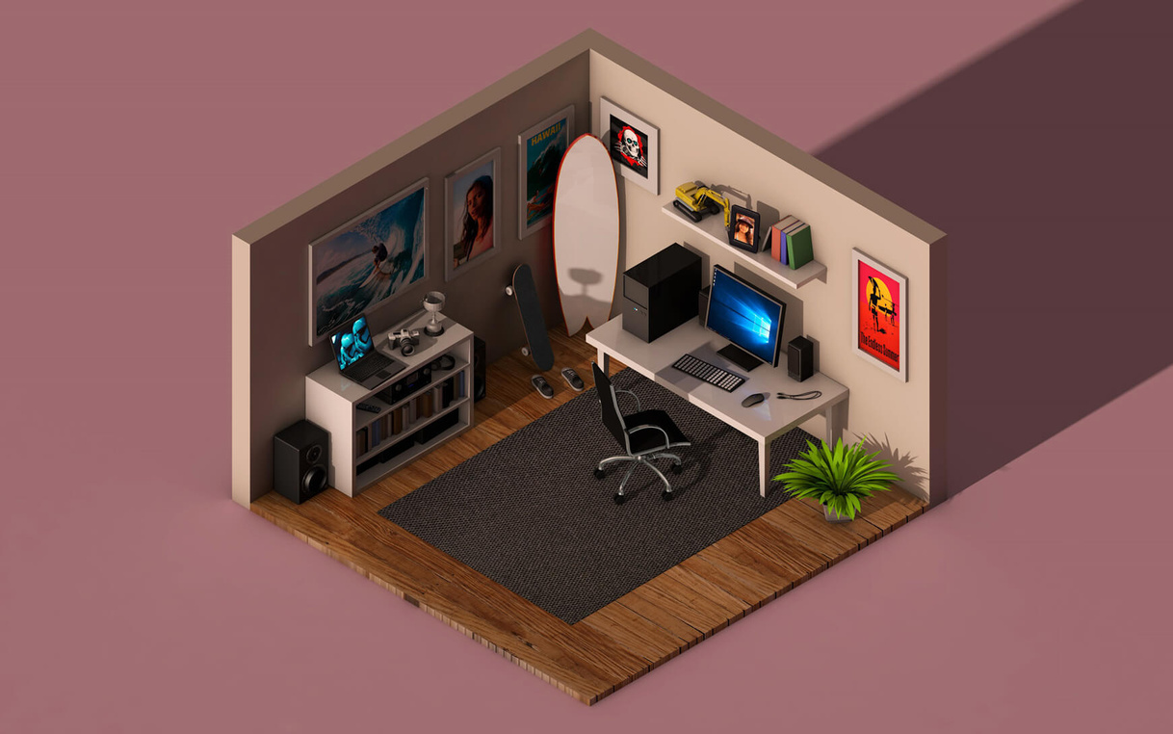
Inspirations
Isometric View
Isometric art style.
Helps scene management and framing - object placement, lighting , etc.
Manage art style, not resource intensive.

Slide 9
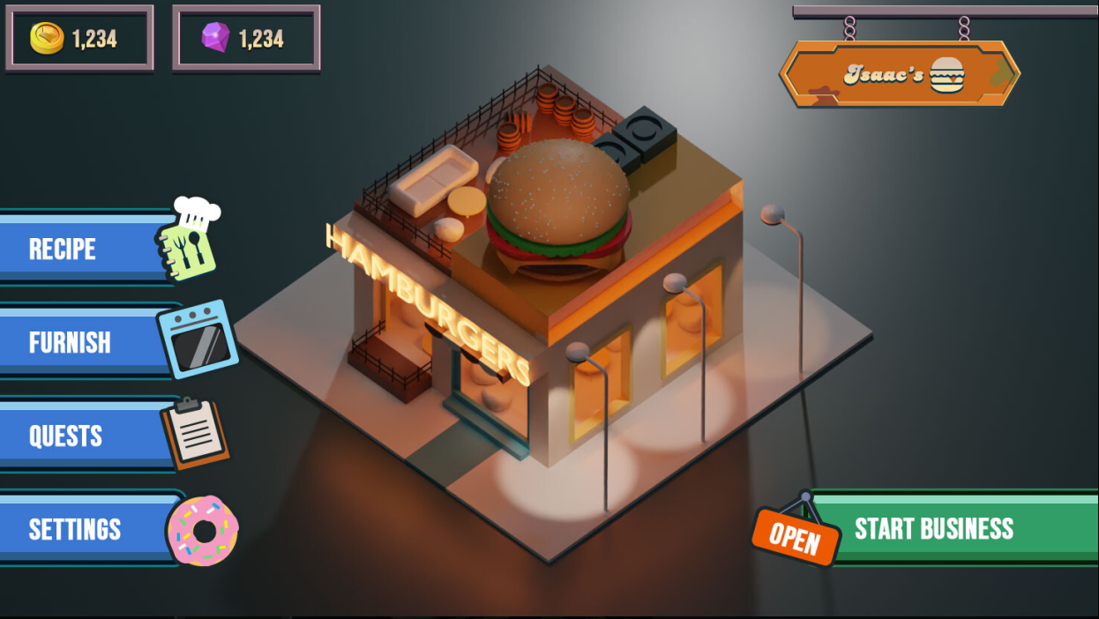
Inspirations
UX and UI
Although this is far colourful, we like how compact it is
It doesn't take away from the main image

Slide 10
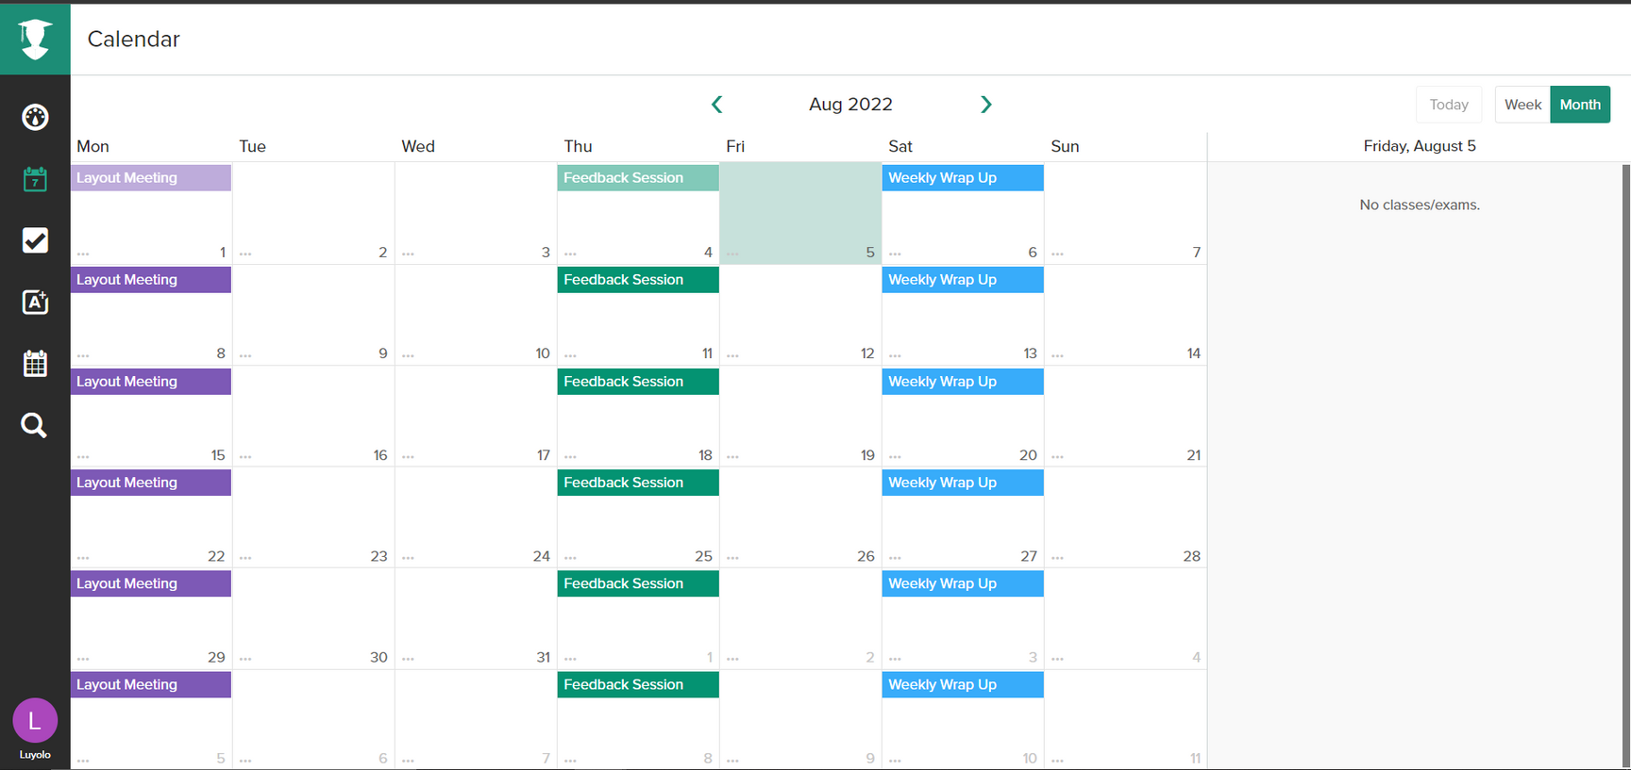

Project Planning & Scheduling
These number are all estimations. We may work more or less than what is prescribed
25
Meeting Structure
Scheduled weekly meetings - 3 times a week
Each meeting will be about 5+ hrs
20
Weekly Hour Quota
15
31 hrs/week
10
Weekly Group Hour Quota
15+ hrs/week
5
Daily Expectations
4.5 hrs+
0
Item 1
Item 2
Item 3
Item 4
Item 5

Slide 11
Project
IDEAL
OUTCOME
Feel good study application
Easy To Use Options
Readable UI
Personal
Developing Skillset - sculpting, Asset optimisation etc.
Industry preparing portfolio project.

Slide 12
THANKS
FOR LISTENING

Slide 13
REFERENCES
https://www.instagram.com/polygonrunway/
https://store.steampowered.com/app/1369320/Virtual_Cottage/
https://www.artstation.com/artwork/D5NNlO
www.reallygreatsite.com

